Slide 1
Data Structure and Algorithms
Azaz Ahmed Kiani

Slide 2
Selection Sort Lesson 7
2

Slide 3
Selection Sort
It is specifically an in-place comparison sort
Noted for its simplicity,
It has performance advantages over more complicated algorithms in certain situations, particularly where auxiliary memory is limited
The algorithm
finds the minimum value,
swaps it with the value in the first position, and
repeats these steps for the remainder of the list
It does no more than n swaps, and thus is useful where swapping is very expensive

Slide 4
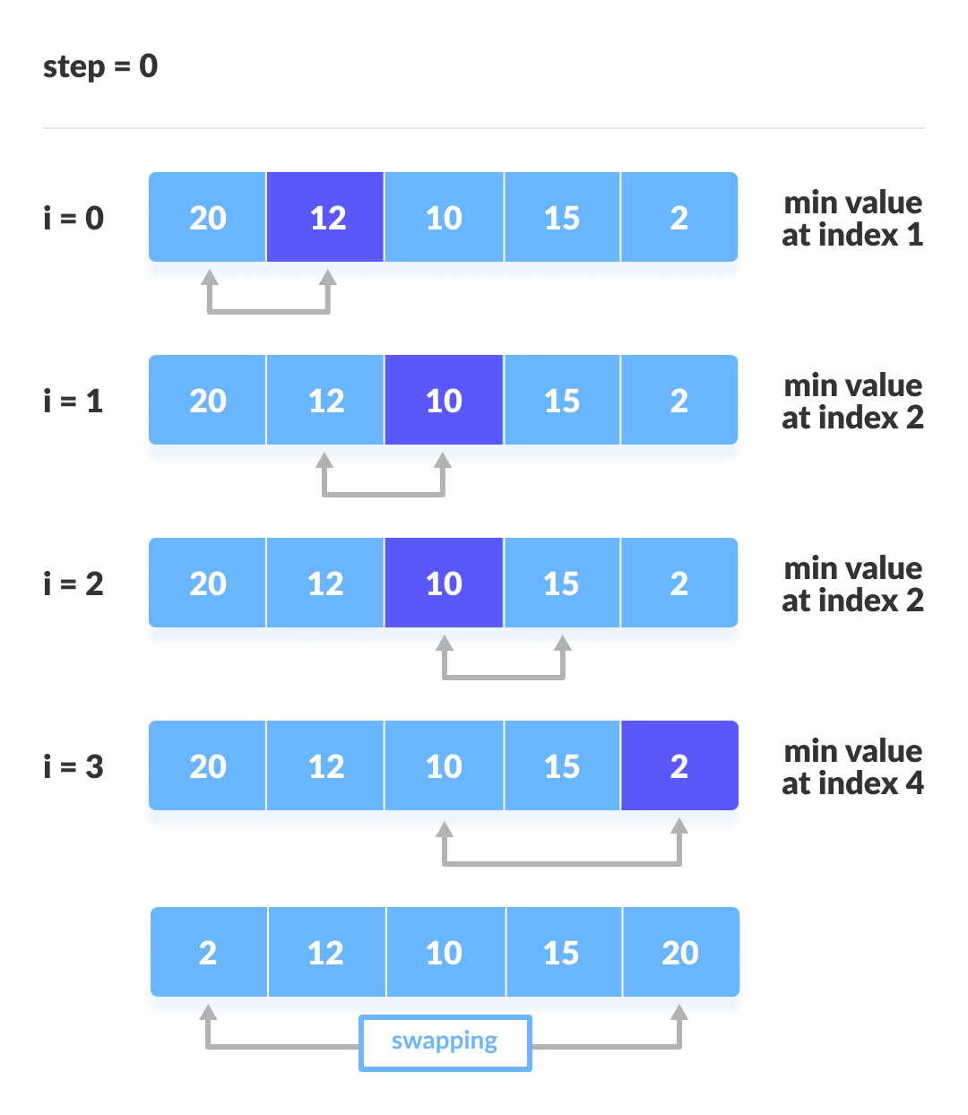
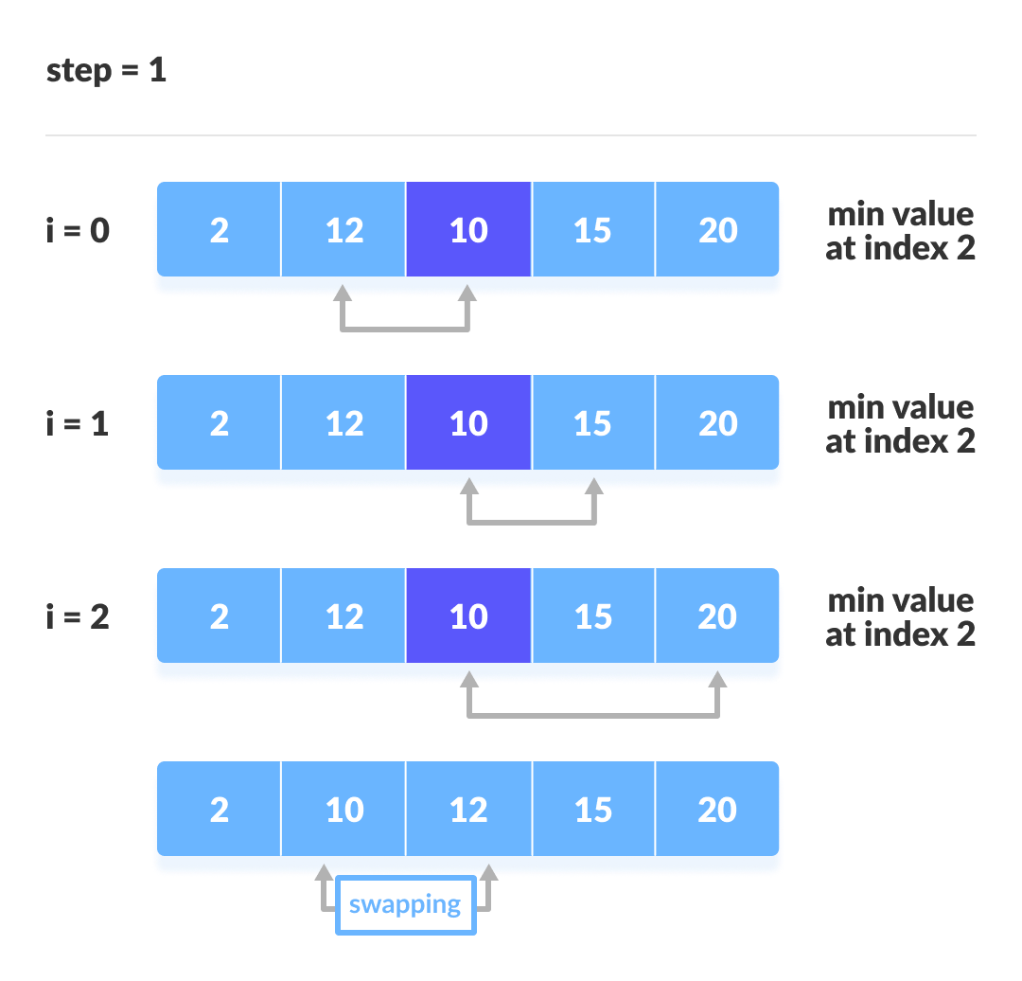
Selection Sort (Concept)
Suppose first element is minimum and then compare it with other elements to find actual minimum
Sorted Side
Unsorted Side
This is array after pass 1. Next pass use this array

Slide 5
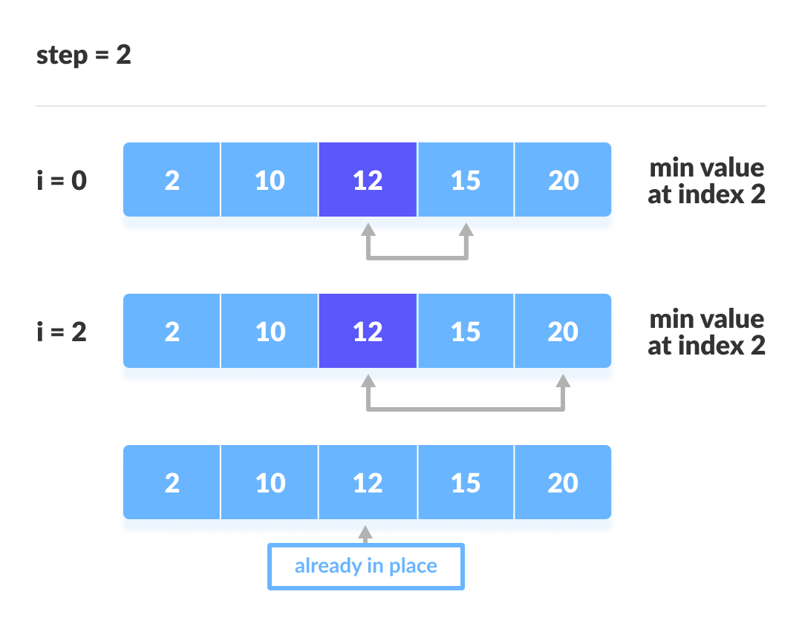
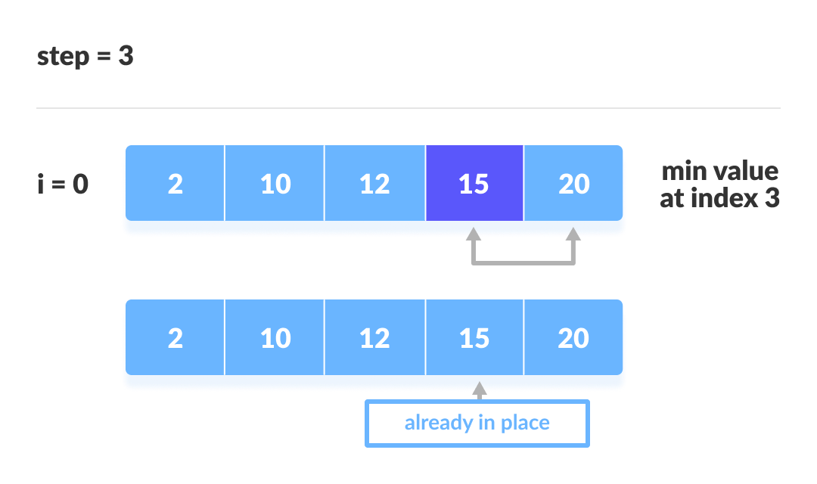
Selection Sort (Concept)
Sorted Side
Unsorted Side

Slide 6
Sorting an Array of Integers
The picture shows an array of six integers that we want to sort from smallest to largest
[0] [1] [2] [3] [4] [5]
Notes:
The picture shows a graphical representation of an array which we will sort so that the smallest element ends up at the front, and the other elements increase to the largest at the end. The bar graph indicates the values which are in the array before sorting--for example the first element of the array contains the integer 45.

Slide 7
The Selection Sort Algorithm
Start by finding the smallest entry.
[0] [1] [2] [3] [4] [5]
Notes:
The first sorting algorithm that we'll examine is called Selectionsort. It begins by going through the entire array and finding the smallest element. In this example, the smallest element is the number 8 at location [4] of the array.

Slide 8
The Selection Sort Algorithm
Start by finding the smallest entry.
Swap the smallest entry with the first entry.
[0] [1] [2] [3] [4] [5]
Notes:
Once we have found the smallest element, that element is swapped with the first element of the array...

Slide 9
The Selection Sort Algorithm
Start by finding the smallest entry.
Swap the smallest entry with the first entry.
[0] [1] [2] [3] [4] [5]
Notes:
...like this.
The smallest element is now at the front of the array, and we have taken one small step toward producing a sorted array.

Slide 10
The Selection Sort Algorithm
Sorted side
Unsorted side
Part of the array is now sorted.
[0] [1] [2] [3] [4] [5]
Notes:
At this point, we can view the array as being split into two sides: To the left of the dotted line is the "sorted side", and to the right of the dotted line is the "unsorted side". Our goal is to push the dotted line forward, increasing the number of elements in the sorted side, until the entire array is sorted.

Slide 11
The Selection Sort Algorithm
Sorted side
Unsorted side
Find the smallest element in the unsorted side.
[0] [1] [2] [3] [4] [5]
Notes:
Each step of the Selectionsort works by finding the smallest element in the unsorted side. At this point, we would find the number 15 at location [5] in the unsorted side.

Slide 12
The Selection Sort Algorithm
Sorted side
Unsorted side
Find the smallest element in the unsorted side.
Swap with the front of the unsorted side.
[0] [1] [2] [3] [4] [5]
Notes:
This small element is swapped with the number at the front of the unsorted side, as shown here...

Slide 13
The Selection Sort Algorithm
Sorted side
Unsorted side
We have increased the size of the sorted side by one element.
[0] [1] [2] [3] [4] [5]
Notes:
...and the effect is to increase the size of the sorted side by one element.
As you can see, the sorted side always contains the smallest numbers, and those numbers are sorted from small to large. The unsorted side contains the rest of the numbers, and those numbers are in no particular order.

Slide 14
The Selection Sort Algorithm
Sorted side
Unsorted side
Smallest
from
unsorted
The process continues...
[0] [1] [2] [3] [4] [5]
Notes:
Again, we find the smallest entry in the unsorted side...

Slide 15
The Selection Sort Algorithm
Sorted side
Unsorted side
The process continues...
Swap
with
front
[0] [1] [2] [3] [4] [5]
Notes:
...and swap this element with the front of the unsorted side.

Slide 16
The Selection Sort Algorithm
Sorted side
is bigger
Sorted side
Unsorted side
The process continues...
[0] [1] [2] [3] [4] [5]
Notes:
The sorted side now contains the three smallest elements of the array.

Slide 17
The Selection Sort Algorithm
The process keeps adding one more number to the sorted side.
The sorted side has the smallest numbers, arranged from small to large.
Sorted side
Unsorted side
[0] [1] [2] [3] [4] [5]
Notes:
Here is the array after increasing the sorted side to four elements.

Slide 18
The Selection Sort Algorithm
We can stop when the unsorted side has just one number, since that number must be the largest number.
Sorted side
Unsorted side
[0] [1] [2] [3] [4] [5]
Notes:
And now the sorted side has five elements.
In fact, once the unsorted side is down to a single element, the sort is completed. At this point the 5 smallest elements are in the sorted side, and so the the one largest element is left in the unsorted side.
We are done...

Slide 19
The Selection Sort Algorithm
The array is now sorted.
We repeatedly selected the smallest element, and moved this element to the front of the unsorted side.
[0] [1] [2] [3] [4] [5]
Notes:
...The array is sorted.
The basic algorithm is easy to state and also easy to program.

Slide 20
Selection Sort – Pseudocode
Input: An array A[1..n] of n elements.
Output: A[1..n] sorted in descending order
1. for i ← 1 to n - 1
2. min ← i
3. for j ← i + 1 to n {Find the i th smallest element.}
4. if A[j] < A[min] then
5. min ← j
6. end for
7. if min ≠ i then interchange A[i] and A[min]
8. end for

Slide 21
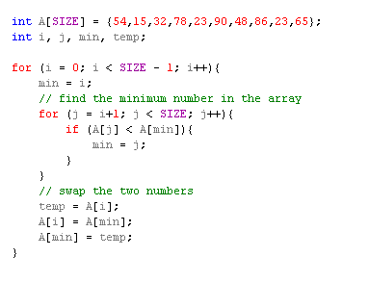
Selection Sort – Implementation

Slide 22
Selection Sort - Implementation Code
void selectionSort (int list[ ] , int size) {
int i, j, temp, min;
for ( i = 0; i < size-1; i++ ) { /* controls passes through the list */
min = i;
for ( j = i+1; j < size; j++ ) /* performs adjacent comparisons */
{
if ( list[ j ] < list[ min] ) /* determines the minimum */
min = j;
} // end of inner for loop
temp = list[i ]; /* swap is performed in outer for loop */
list[ i ] = list[min];
list[min] = temp;
} // end of outer for loop
} // end of function

Slide 23
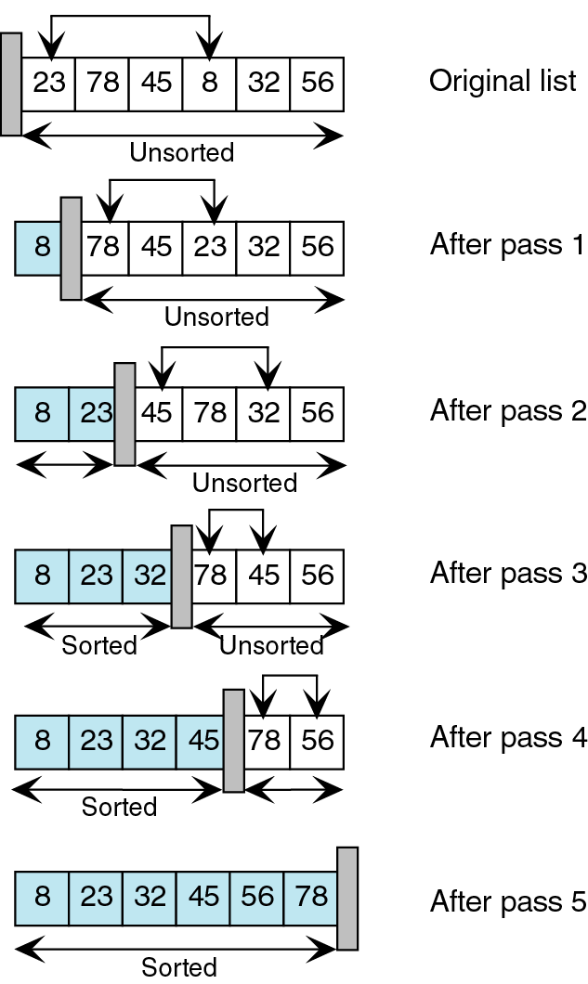
Selection Sort - Step through
Again, we search the unsorted list for the smallest element.
We then exchange the smallest element (23) with the first element in the unsorted list (78) and move the conceptual wall.
We start with an unsorted list. We search this list for the smallest element.
We then exchange the smallest element (8) with the first element in the
unsorted list (23) and move theconceptual wall.
This process continues until the list is fully sorted.

Slide 24
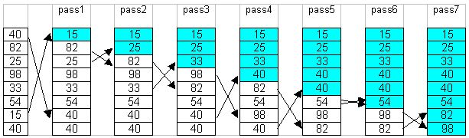
Selection Sort Example
To sort an array with k elements, Selection sort requires k – 1 passes.
Example:

Slide 25
Selection Sort - Animation

Slide 26
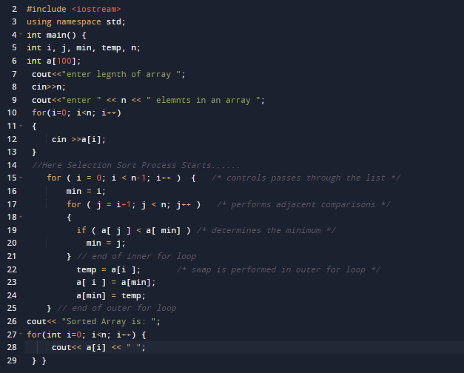
Selection Sort (complete Example)

Slide 27
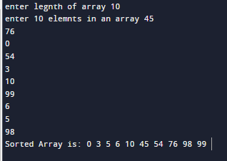
Selection Sort (complete Example)

Slide 28
Complexity of Selection Sort
An in-place comparison sort
O(n²) complexity, making it inefficient on large lists, and generally performs worse than the similar insertion sort.
Selection sort is not difficult to analyze compared to other sorting algorithms since none of the loops depend on the data in the array

Slide 29
Complexity of Selection Sort
Worst case performance
Best case performance
Average case performance
Where n is the number of elements being sorted
29

Slide 30
Summary…
Questions…?

